Slide 1
Poetry Makes Nothing Happen
Dr Faisal Nazir

Slide 2
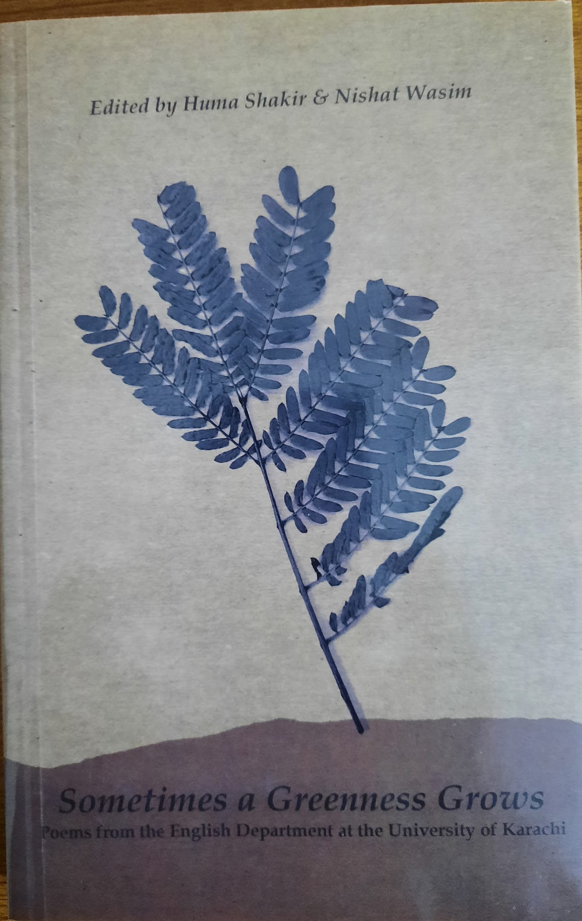
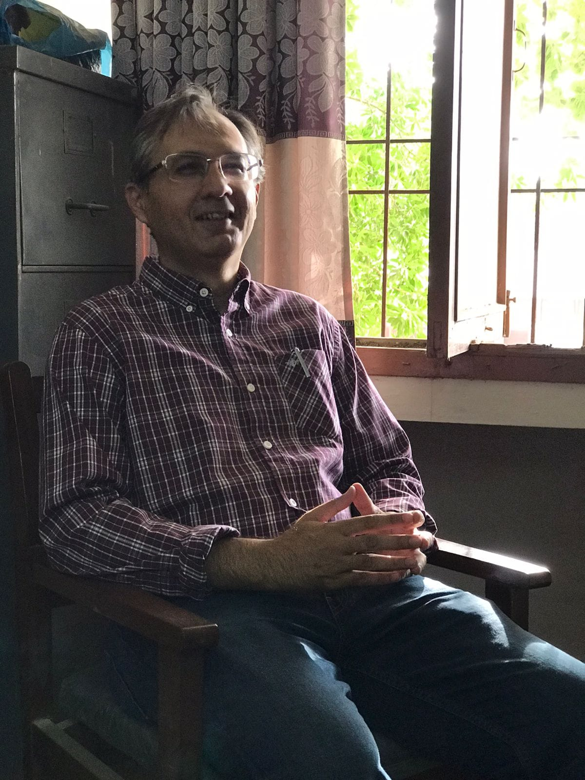
The Poet

Slide 3
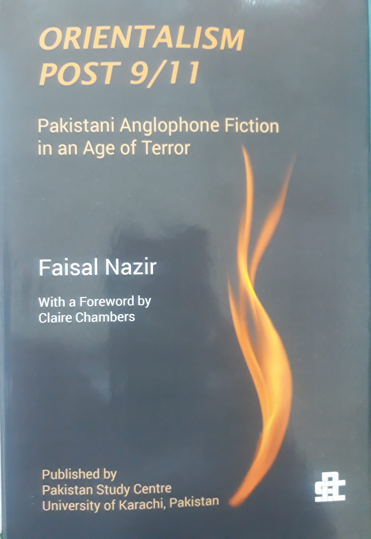
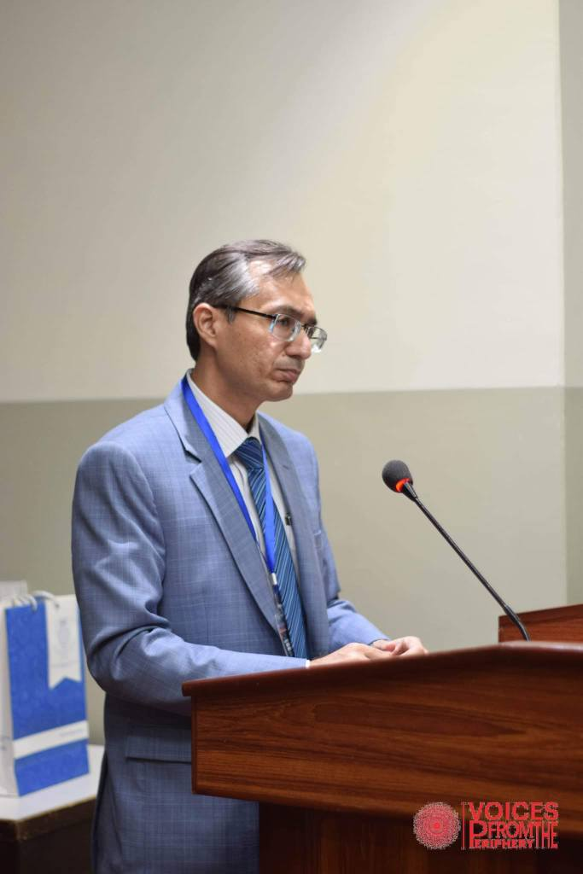
The Academic

Slide 4
Poetry Makes Nothing Happen
For poetry makes nothing happen: it survives
In the valley of its making where executives
Would never want to tamper, flows on south
From ranches of isolation and the busy griefs,
Raw towns that we believe and die in; it survives,
A way of happening, a mouth.
- W.H. Auden, “In Memory of W.B. Yeats”

Slide 5
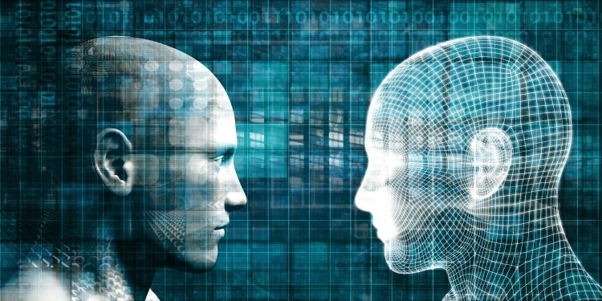
Poetry in the Age of Artificial Intelligence

Slide 6






All changed, changed utterly
WB Yeats, “Easter 1916”

Slide 7
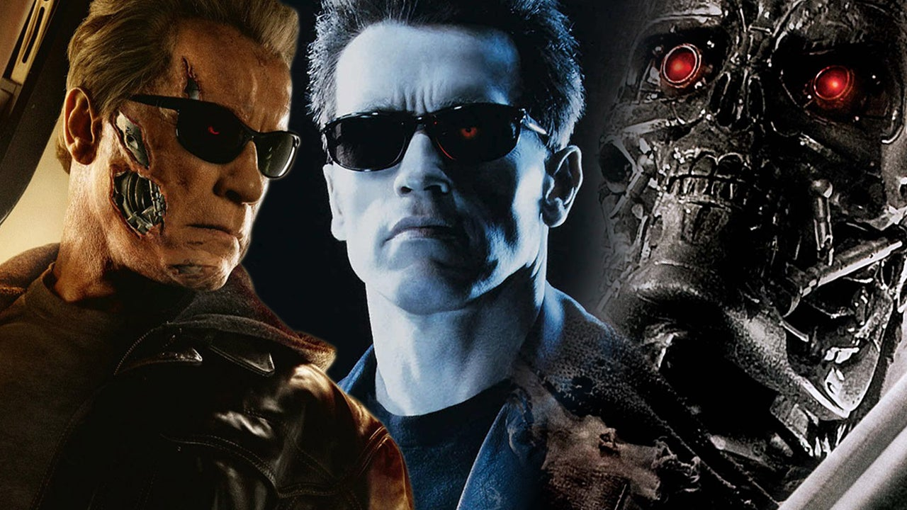
A terrible beauty is born
WB Yeats, “Easter 1916”

Slide 8
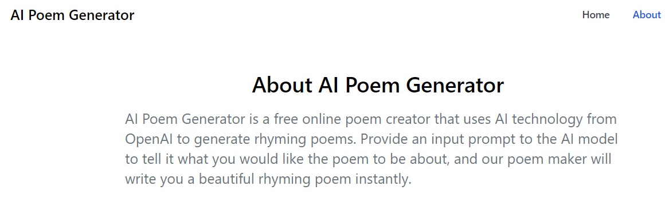
Words alone are certain good (?)
WB Yeats, “Song of the Happy Shepherd”

Slide 9
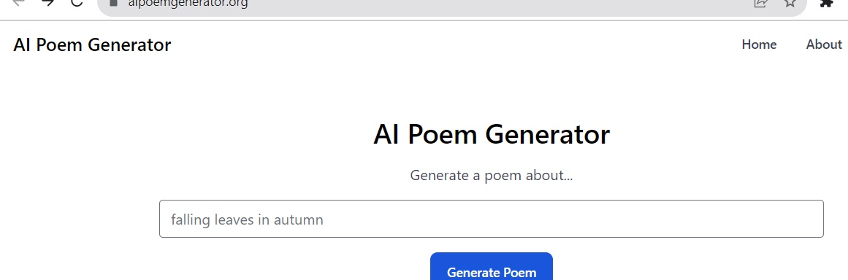
A line will take us hours maybe
WB Yeats, “Adams Curse”

Slide 10
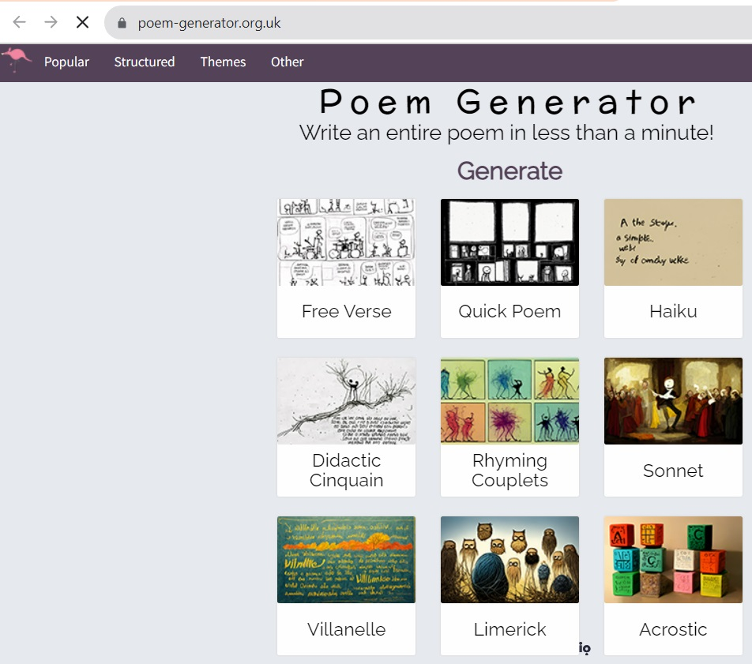
Ars Poetica by Archibald MacLeish
A poem should not mean
But be.

Slide 11

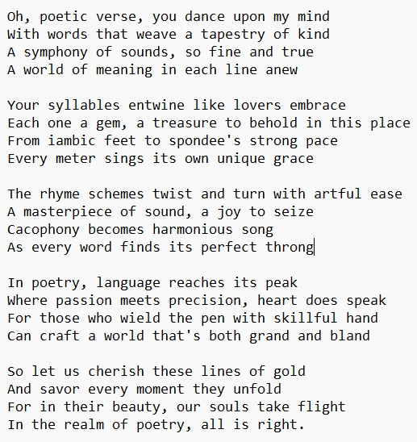
“Poetry”
Poem Generator

Slide 12
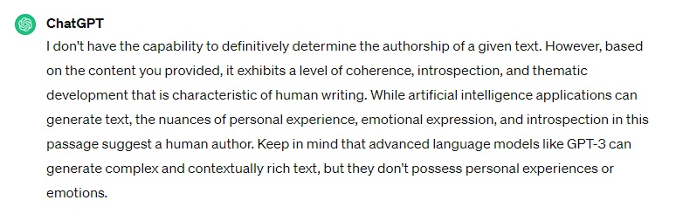
ChatGPT Response

Slide 13
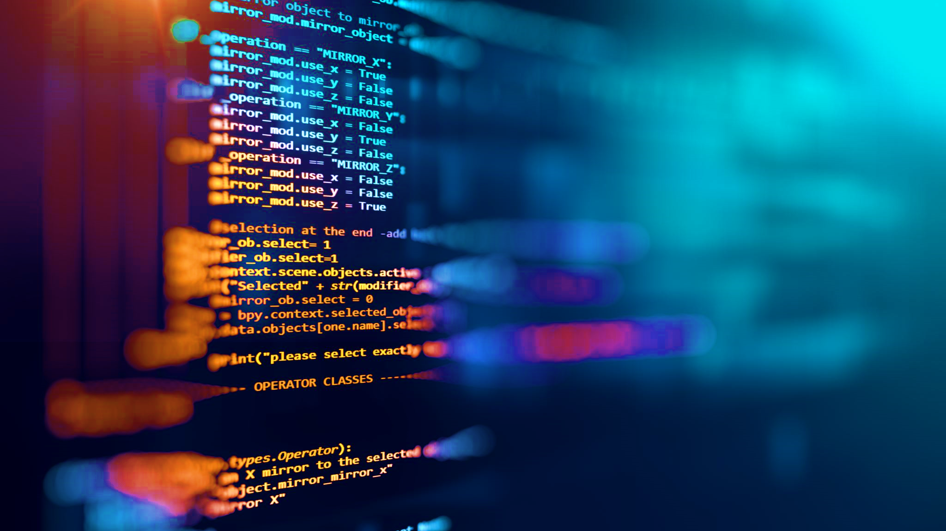
ChatGPT’s Confession
While artificial intelligence applications can generate text, the nuances of personal experience, emotional expression, and introspection in this passage suggest a human author. Keep in mind that advanced language models like GPT-3 can generate complex and contextually rich text, but they don't possess personal experiences or emotions.

Slide 14
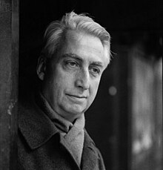
The Death of the Author
Having buried the Author, the modern scriptor can thus no longer believe, … that this hand is too slow for his thought or passion and that consequently, making a law of necessity, he must emphasize this delay and indefinitely ‘polish’ his form. For him, on the contrary, the hand, cut off from any voice, borne by a pure gesture of inscription (and not of expression), traces a field without origin—or which, at least, has no other origin than language itself, language which ceaselessly calls into question all origins.

Slide 15
The Death of the Author
“Did he wish to express himself, he ought at least to know that the inner ‘thing’ he thinks to translate is itself only a ready-formed dictionary, its words only explainable through other words, and so on indefinitely …”

Slide 16
The Birth of the Reader
The reader is the space on which all the quotations that make up a writing are inscribed without any of them any of them being lost; a text’s unity lies not in its origin but in its destination. Yet this destination cannot any longer be personal: the reader is without history, biography, psychology; he is simply that someone who holds together in a single field all the traces by which the written text is constituted.

Slide 17
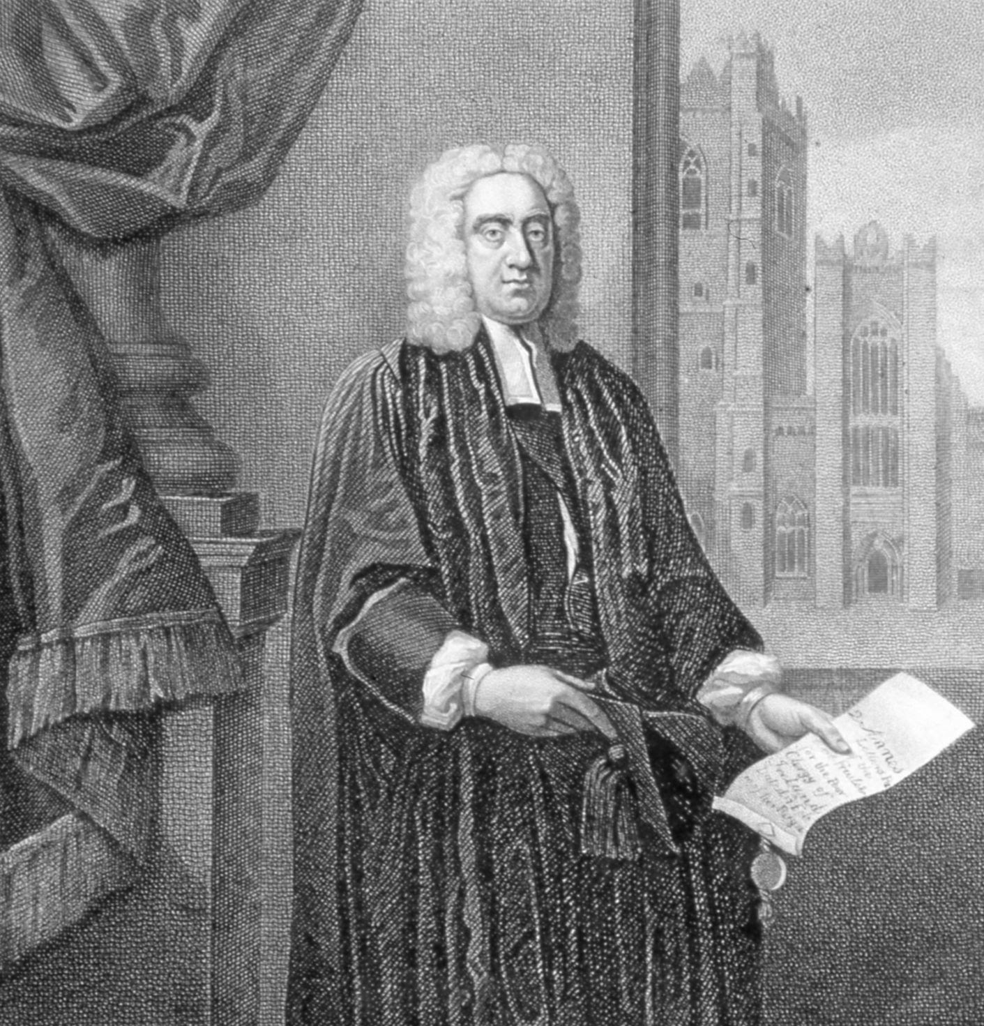
The Academy of Lagado
Six hours a day the young students were employed in this labour; and the professor showed me several volumes in large folio, already collected, of broken sentences, which he intended to piece together, and out of those rich materials, to give the world a complete body of all arts and sciences; which, however, might be still improved, and much expedited, if the public would raise a fund for making and employing five hundred such frames in Lagado, and oblige the managers to contribute in common their several collections.

Slide 18
The Academy of Lagado
He assured me “that this invention had employed all his thoughts from his youth; that he had emptied the whole vocabulary into his frame, and made the strictest computation of the general proportion there is in books between the numbers of particles, nouns, and verbs, and other parts of speech.”

Slide 19
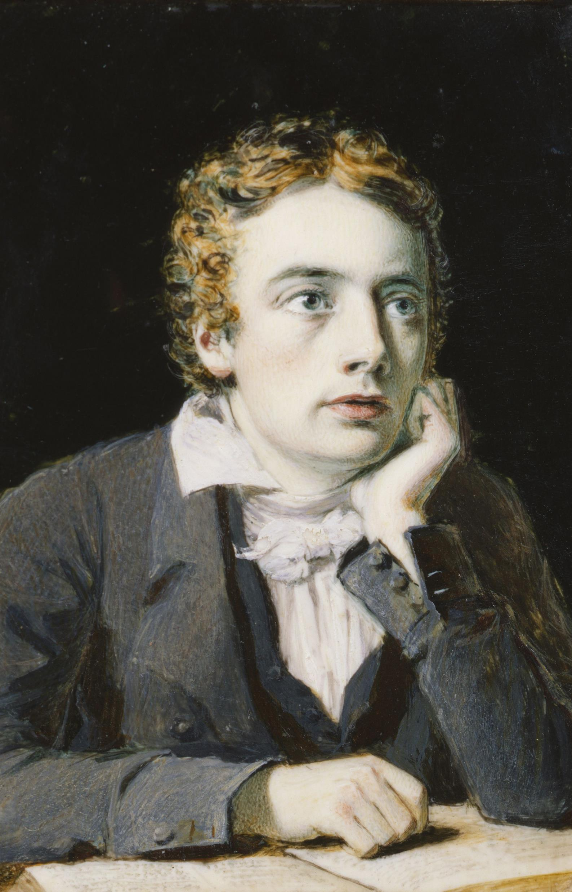
The Poet
A Poet is the most unpoetical of any thing in existence; because he has no Identity - he is continually in for - and filling some other Body - The Sun, the Moon, the Sea and Men and Women who are creatures of impulse are poetical and have about them an unchangeable attribute - the poet has none; no identity - he is certainly the most unpoetical of all God's Creatures.

Slide 20
Conclusion: The Poet and the Poetaster
The excellence of every art is its intensity, capable of making all disagreeables evaporate, from their being in close relationship with Beauty and Truth.

Slide 21
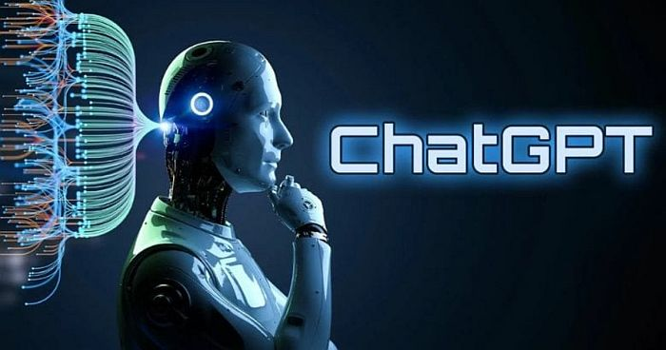
The Bot Speaks
Keep in mind that advanced language models like GPT-3 can generate complex and contextually rich text, but they don't possess personal experiences or emotions.

